Slide 1

Implementing the Child Safe Standards
Scenario discussion guide

Slide 2






The Child Safe Organisations law aims to protect children from harm when they interact with businesses and organisations.
Keep this in mind as you work through this resource, and continually ask:
“How can our organisation create an environment that prioritises children’s safety and protects them from harm?”

Slide 3




How to use this guide
This resource will help you to understand the Act, reflect on your organisation’s practices, and identify the actions you need to take to better protect children from harm.
Watch the video for each Standard.
Discuss the reflection prompts and how the Standard applies in your organisation.
Following your discussion, work through the key takeaways to complete your understanding.
Document your reflections and the actions your organisation will take.
Notes:
Guidance instructions
Use scenarios as written or adapt them to your organisation’s context.
Some Standards include more than one scenario to help build your knowledge and ability to apply it in practice.
Complete the activities individually or in groups—discussion is encouraged.
Work through the Standards in one session or across multiple shorter discussions—adapt to suit your organisation’s learning needs.
Refer to our Guidelines or Quick Reference Guide for more information on each of the Standards. You may also want to complete the Self-Assessment Tool as you work through this resource.

Slide 4
Learn and reflect
Videos, scenarios and reflective discussions

Slide 5











STANDARD 1: Leadership and culture Child safety and wellbeing is embedded in the entity’s organisational leadership, governance and culture.
STANDARD 2: Voice of children Children are informed about their rights, participate in decisions affecting them and are taken seriously.
STANDARD 3: Family and community Families and communities are informed and involved in promoting child safety and wellbeing.
STANDARD 4: Equity and diversity Equity is upheld and diverse needs respected in policy and practice.
STANDARD 5: People People working with children are suitable and supported to reflect child safety and wellbeing values in practice.
STANDARD 6: Complaints management Processes to respond to complaints and concerns are child-focused.
STANDARD 7: Knowledge and skills Staff and volunteers of the entity are equipped with the knowledge, skills and awareness to keep children safe through ongoing education and training.
STANDARD 8: Physical and online environments Physical and online environments promote safety and wellbeing and minimise the opportunity for children to be harmed.
STANDARD 9: Continuous improvement Implementation of the child safe standards is regularly reviewed and improved.
STANDARD 10: Policies and procedures Policies and procedures document how the entity is safe for children.
UNIVERSAL PRINCIPLE
A child safe entity must provide an environment that promotes and upholds the right to cultural safety of children who are Aboriginal persons or Torres Strait Islander persons.
Notes:
These are the 10 Child Safe Standards. They closely align with the National Principles for Child Safe Organisations.
The Standards create safe environments for children by requiring organisations to prioritise the safety of children in their culture, governance, policies and practices.
When implementing the Standards, organisations also need to create environments that promote and uphold the right to cultural safety for Aboriginal and Torres Strait Islander children, which is known in the legislation as the Universal Principle. This means making Aboriginal and Torres Strait Islander children feel welcome, safe, valued, included and respected.
The Universal Principle is embedded through each Standard—when considering how each Standard applies in your organisation, consider how cultural safety also applies.

Slide 6

Watch the video then discuss:
Is children’s safety and wellbeing embedded in our leadership, governance, and culture?
Do we champion a child safe culture at all levels of the organisation?
WATCH Standard 1: Leadership and culture
6
Notes:
Guidance
Refer to pages 7-9 of the Self-Assessment tool for more prompts to guide your reflection on Leadership and Culture

Slide 7

Standard 1 is the engine room of children’s safety.
When leaders visibly prioritise children’s safety, allocate resources, model accountability, and weave protection and prevention into every decision, they activate a cascading effect.
Standard 1 doesn't just support the other standards - it breathes life into them.
As you work through the scenarios throughout this presentation, consider how leadership can enable culture transformation for each standard.
Without a genuine leadership commitment to prioritising safety into governance, strategy, culture, policy and practice, the other standards risk becoming compliance exercises rather than transformative change.

Slide 8
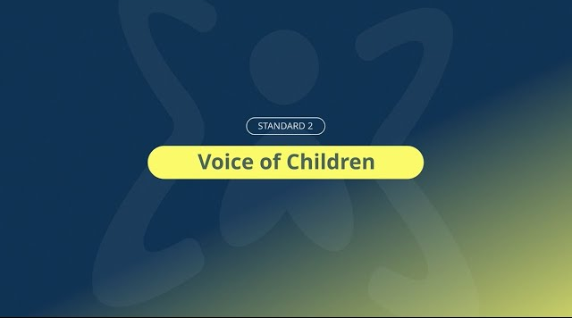

Watch the video then discuss:
What do we do well?
Where could we improve?
What is currently missing or not done?
WATCH Standard 2: Voice of children
Notes:
Tip: Refer to pages 10-11 of the Self-Assessment tool for more prompts to guide your reflection on Voice of Children.

Slide 9



Scenario
An organisation receives feedback that some children have concerns about the behaviour of staff, but they either don’t know how to raise concerns or are reluctant to speak up out of fear of repercussions by workers.
In your organisation:
How do you currently manage situations like this?
What do you currently have in place to ensure children remain safe? Would you need to involve other expertise within your organisation or seek any further information?
How do you embed cultural safety?
What evidence do you already have to demonstrate how you safeguard children in these situations?
What do you need to develop to fill any gaps?
In this scenario:
How does Child Safe Standard 2 apply?
What other Standards could apply?
What are the potential risks to children and the organisation if the Standards are not embedded?
What reflection and feedback processes could be implemented to ensure you are continuously improving?
Notes:
Guidance
This scenario considers multiple Child Safe Standards, which include cultural safety:
Standard 1: Leadership and Culture
Standard 2: Voice of Children
Standard 3: Family and Community
Standard 5: People
Standard 6: Complaints Management
Standard 9: Continuous Improvement
First discuss how the standards apply to the scenario.
Then reflect on how you manage situations like this in your organisation.

Slide 10
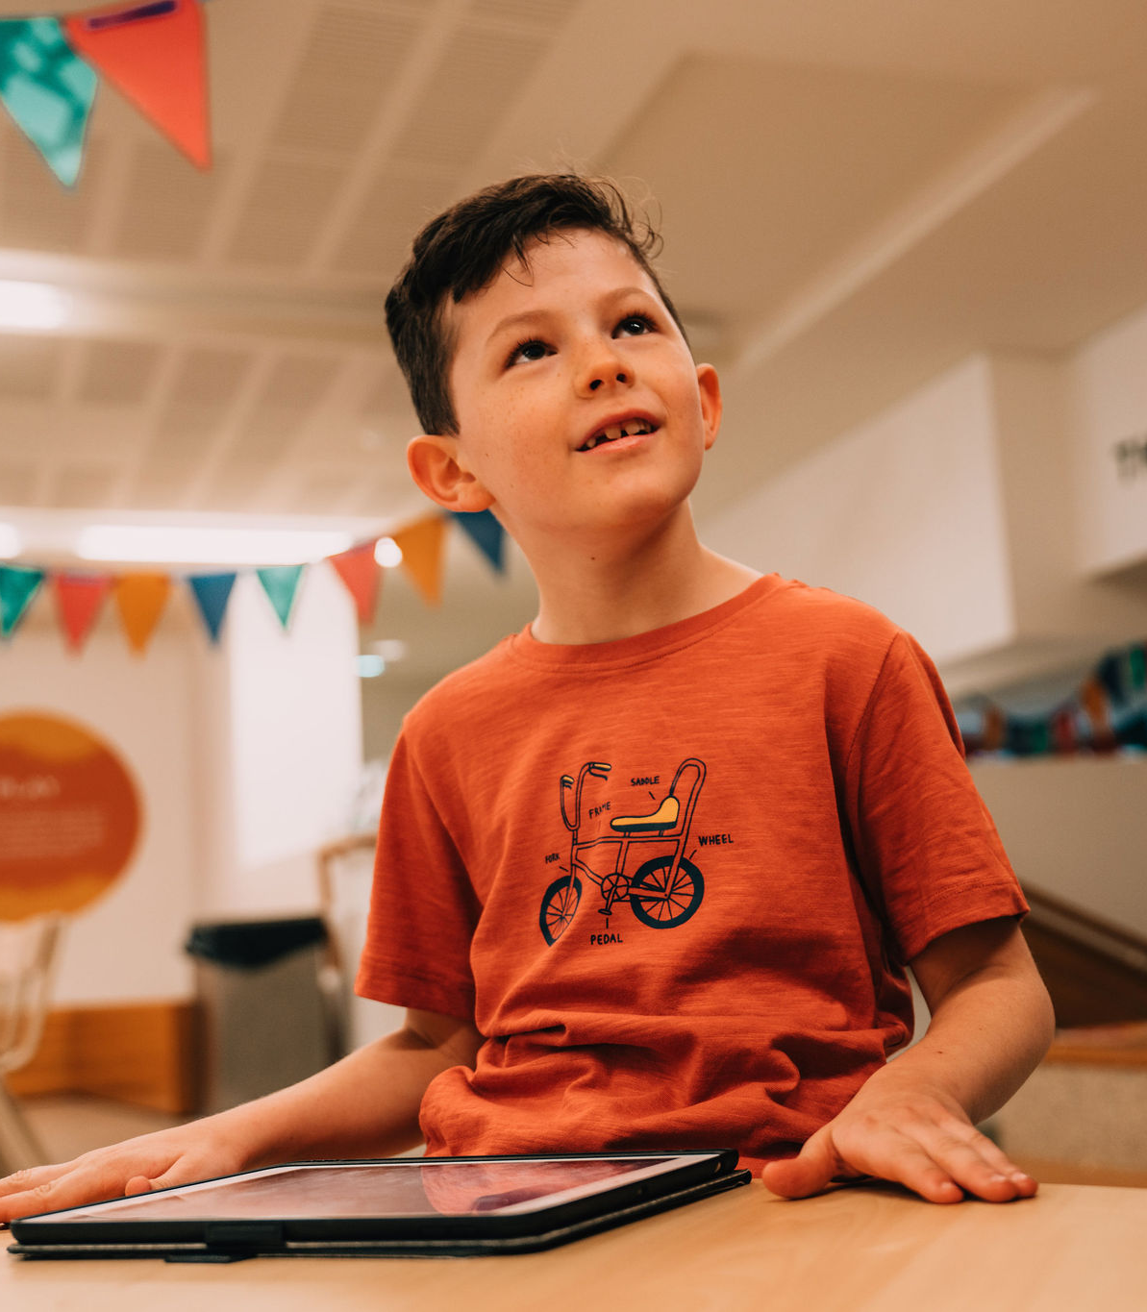
Key takeaways
Children should always feel comfortable expressing their concerns and should feel confident they will be heard, believed and not treated differently.
Children should know how to report concerns, and organisations should proactively seek to understand whether children feel safe and the reasons for their answers.
Organisations need to have processes in place to take action on what they hear from children, which needs to include a feedback loop with the child.
Workers need to be equipped with the knowledge to recognise when a child is communicating a concern, including when the child is non- or pre-verbal.
Organisations need to have mechanisms in place that eliminate barriers that could prevent children from reporting – this includes considering children’s abilities, ages, cultural backgrounds, and lived experiences.
Based on what you have heard about this Standard, discuss the actions you need to take to implement it in your organisation
Notes:
Additional takeaways you may want to consider for this standard and scenario:
If your organisation is making decisions about children, consider how you can include the perspectives of children and demonstrate genuine respect for their views.
Regularly ask whether children feel safe when interacting with your organisation.
When designing spaces, programs or services for children, engage children in the process and seek their views about how they would feel safe in that setting.
Creating spaces where children know about their right to safety and are confident in their ability to express concerns, provide input, and participate in meaningful ways is an important aspect of prioritising their safety. You can communicate this to children in conversations, through posters on your site, surveys, or in information provided through parents. These are just some examples. How you seek the views of children will be different for every organisation depending on how you interact with children, your resourcing, and circumstances.
The adults who support children in your organisation need to understand and respect children’s agency and take steps to ensure they are treated as competent and capable. This means adults tailor their approach based on the age, developmental stage, culture and any other specific needs of the child.
Where relevant to the setting, offer children access to age-appropriate information or programs about preventing abuse.
Your staff need to know how to identify risks of harm and know what to do if a child reports a concern or discloses they have experienced harm.
Make sure your processes for seeking feedback and responding to harm are appropriate for the children involved – this means tailoring for varying ages, cultural backgrounds, abilities and lived experiences. You can consider developing any resources in consultation with children.
Consider how cultural safety looks – how do you ensure Aboriginal and Torres Strait Islander children feel comfortable and confident providing feedback or reporting concerns? How do you work with children and families to understand how you can improve and build trust and confidence.

Slide 11

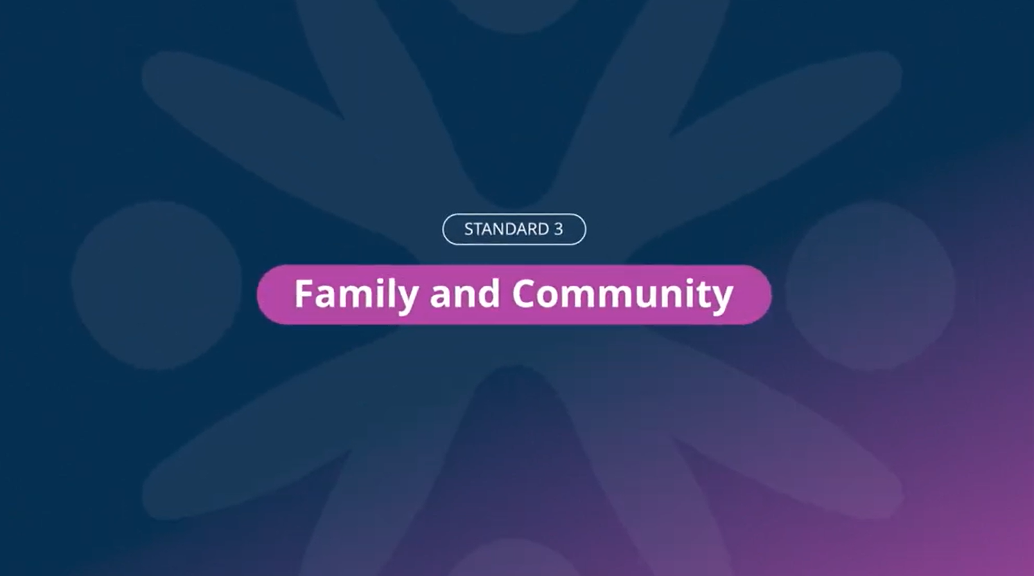

Watch the video then discuss:
What do we do well?
Where could we improve?
What is currently missing or not done?
WATCH Standard 3: Family and community
11
Notes:
Tip: Refer to pages 12-13 of the Self-Assessment tool for more prompts to guide your reflection on Family and Community.

Slide 12



Scenario
Workers at an organisation observe changes in a child’s behaviour that appear concerning. The child’s parent has not proactively raised any concerns with the organisation.
In your organisation:
How do you currently manage situations like this?
What do you currently have in place to ensure children remain safe? Would you need to involve other expertise within your organisation or seek any further information?
How do you embed cultural safety?
What evidence do you already have to demonstrate how you safeguard children in these situations?
What do you need to develop to fill any gaps?
In this scenario:
How does Child Safe Standard 3 apply?
What other Standards could apply?
What are the potential risks to children and the organisation, if the Standards are not embedded?
What reflection and feedback processes could be implemented to ensure you are continuously improving?
Notes:
Guidance
This scenario considers multiple Child Safe Standards, which include cultural safety:
Standard 1: Leadership and Culture
Standard 2: Voice of Children
Standard 3: Family & Community
Standard 4: Equity and Diversity
Standard 5: People
Standard 6: Complaints Management
Standard 7: Knowledge and Skills
Standard 10: Policies and Procedures
First discuss how the standards apply to the scenario.
Then reflect on how you manage situations like this in your organisation.

Slide 13

Key takeaways
Children’s safety is strengthened when families and communities are informed and engaged and are active partners in promoting safe environments for children.
Families and communities play a critical, shared role in protecting children, and organisations should look for ways to foster strong, transparent relationships with them.
You can do this by providing opportunities for families to participate in decisions affecting their child, which could include developing or reviewing policies and practices.
Look for ways to communicate meaningfully and regularly with families and communities about your approach to protecting children’s safety.
Provide families and communities with clear and accessible information about your safety and wellbeing policies and practices.
Based on what you have heard about this Standard, discuss the actions you need to take to implement it in your organisation
Notes:
Additional takeaways you may want to consider for this standard and scenario:
Respect that every family and community looks different and will have different views and needs. This includes being mindful of family demographics (such as traditional families, step-families, foster families, kinship families). Be mindful that families, parents and primary carers are broad terms that may have different meanings for Aboriginal and Torres Strait Islander peoples.
Communicate in ways that are appropriate to families’ and communities’ needs and welcome and encourage input from them.
In this scenario, the organisation should consider how they can best partner with the parent to raise the concerns observed and discuss the organisation’s role in providing support. They can consider any barriers to engaging with the parent and consider ways to overcome them – these may include time, trust, power dynamic, cultural or linguistic barriers.
The organisation may look at ways it communicates with parents and families and considers whether any improvements are required to make it easier for parents, communities and parents to engage and participate in the way they safeguard children.

Slide 14


Watch the video then discuss:
What do we do well?
Where could we improve?
What is currently missing or not done?
WATCH Standard 4: Equity and diversity
14
Notes:
Tip: Refer to pages 14-15 of the Self-Assessment tool for more prompts to guide your reflection on Equity and Diversity

Slide 15



Scenario
An organisation conducts a feedback survey with parents and carers. The results show that many families don’t understand the policies and procedures in place to protect children and some don’t feel comfortable or confident to raise a concern.
In your organisation:
How do you currently manage situations like this?
What do you currently have in place to ensure children remain safe? Would you need to involve other expertise within your organisation or seek any further information?
How do you embed cultural safety?
What evidence do you already have to demonstrate how you safeguard children in these situations?
What do you need to develop to fill any gaps?
In this scenario:
How does Child Safe Standard 4 apply?
What other Standards could apply?
What are the potential risks to children and the organisation if the Standards are not embedded?
What reflection and feedback processes could be implemented to ensure you are continuously improving?
Notes:
Guidance
This scenario considers multiple Child Safe Standards, which include cultural safety:
Standard 1: Leadership and Culture
Standard 2: Voice of Children
Standard 3: Family and Community
Standard 4: Equity and Diversity
Standard 5: People
Standard 6: Complaints Management
Standard 7: Knowledge and Skills
Standard 9: Continuous Improvement
Standard 10: Policy and Procedures
First discuss how the standards apply to the scenario.
Then reflect on how you manage situations like this in your organisation.

Slide 16

Key takeaways
Reflect on potential barriers that discourage children, families and workers from speaking up or engaging with the organisation.
Proactively address barriers arising from cultural influences, lack of trust and power imbalances (for example, age, seniority, employment status or past experiences).
Ensure concerns can be raised by children, parents, carers and adults, with reporting pathways that are:
clearly communicated
accessible
child‑friendly
safe and responsive.
Based on what you have heard about this Standard, discuss the actions you need to take to implement it in your organisation
Notes:
Additional takeaways you may want to consider for this standard and scenario:
The Standards place clear responsibilities on the organisation and workers to ensure children’s safety and that their voice is respected.
Organisations should not assume all children will feel able to report concerns directly.
When children are reluctant to raise concerns, this in itself is a safety indicator. It may indicate:
a lack of trust in staff
fear of repercussions
unclear or inaccessible reporting pathways.
Organisations should reflect on:
Do children know who they can talk to if they feel unsafe?
Are there multiple reporting options in place?
Are workers trained to respond appropriately?
The barriers that might exist which could discourage children, families and workers from speaking up and how could they be addressed
Their process for responding to and investigating concerns
How they provide feedback on progress and the outcomes of any investigation
Organisations should reflect on the barriers that might exist which could discourage children, families and workers from speaking up or meaningfully engaging with the organisation.

Slide 17


Watch the video then discuss:
What do we do well?
Where could we improve?
What is currently missing or not done?
WATCH Standard 5: People
17
Notes:
Tip: Refer to pages 16-17 of the Self-Assessment tool for more prompts to guide your reflection on People

Slide 18



Scenario
An organisation engages a new volunteer who is enthusiastic and clearly enjoys spending time with children. A worker notices that the volunteer regularly offers to drive children home to help busy parents and carers, often stays back to provide extra support to some children, regularly posts photos on social media featuring their work with children, and has built relationships with families including connecting on social media and sharing phone numbers. The volunteer has recently moved from interstate. The worker believes referee checks weren’t completed, as the organisation was in desperate need of volunteers, and the worker is concerned the person may be a risk to children.
In your organisation:
How do you currently manage situations like this?
What do you currently have in place to ensure children remain safe? Would you need to involve other expertise within your organisation or seek any further information?
How do you embed cultural safety?
What evidence do you already have to demonstrate how you safeguard children in these situations?
What do you need to develop to fill any gaps?
In this scenario:
How does Child Safe Standard 5 apply?
What other Standards could apply?
What are the potential risks to children and the organisation, if the Standards are not embedded?
What reflection and feedback processes could be implemented to ensure you are continuously improving?
Notes:
Guidance
This scenario considers multiple Child Safe Standards, which include cultural safety:
Standard 1: Leadership and Culture
Standard 5: People
Standard 6: Complaints Management
Standard 7: Knowledge and Skills
Standard 8: Physical and Online Environments
Standard 9: Continuous Improvement
Standard 10: Policies and Procedures
First discuss how the standards apply to the scenario.
Then reflect on how you manage situations like this in your organisation.

Slide 19

Key takeaways
Assess both eligibility and suitability when engaging anyone to work with children, including volunteers.
Leaders must model an approach in all recruitment decisions that prioritises children’s safety, even in circumstances of short staffing or urgent need. This ensures every worker in every situation has the knowledge, skills and demonstrated experience to care for children.
Recruitment processes should reflect the organisation’s commitment to children’s safety.
Provide a strong induction on safety policies and the code of conduct.
Use probation, supervision, and performance monitoring to confirm ongoing suitability.
Make sure all staff know how to identify risks of harm and know how to report them.
Working With Children Checks shouldn’t be relied on as a sole way to protect children from harm.
Based on what you have heard about this Standard, discuss the actions you need to take to implement it in your organisation
Notes:
Additional takeaways you may want to consider for this standard and scenario:
When engaging an individual to work with children it is essential to consider both their eligibility and their suitability, taking into account:
the nature of the work and the setting
the level and intensity of the interactions they will have with children
the age and characteristics of the children they will be working with.
Even when a candidate seems ideal, leaders must model a mindset that prioritises children’s safety. The child safeguarding culture of the organisation is reflected in how recruitment processes are undertaken.
Be aware that people who seek to harm children are often deceptive and manipulative. Ongoing training and awareness for staff is essential to ensure they are vigilant and can recognise the risks to children.
A Working with Children check indicates no known disqualifying offences exist, but it is not sufficient on its own to determine suitability.
The scenario notes that the worker has moved from interstate. Given they haven’t worked in Queensland, some past issues may not appear in the screening system. The lack of recent references or incomplete employment history may mask performance or conduct concerns. Organisations should verify reference checks and clearance verification outside Queensland and follow up on the missing referee. They should consider obtaining a verbal reference, understanding the relationship of the referee to the applicant and ensuring that a referee can comment on their suitability to work with children and their performance in this regard.
All new workers, including volunteers, should receive a proper induction that reinforces safe practices, with explicit reference to the organisation’s code of conduct. Implementing probation periods, supervision, and ongoing performance monitoring will help to build confidence that the person is suitable to work with children.

Slide 20
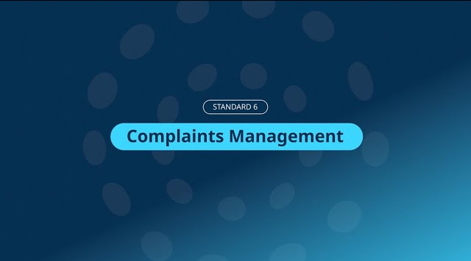

Watch the video then discuss:
What do we do well?
Where could we improve?
What is currently missing or not done?
WATCH Standard 6: Complaints management
20
Notes:
Tip: Refer to pages 18-20 of the Self-Assessment tool for more prompts to guide your reflection on Complaints Management.

Slide 21



Scenario
A new worker has observed a more senior employee speaking harshly to children and, in one instance, roughly handling them. The worker is unsure of how to raise their concerns and what the impact might be on their own employment if they speak up.
In your organisation:
How do you currently manage situations like this?
What do you currently have in place to ensure children remain safe? Would you need to involve other expertise within your organisation or seek any further information?
How do you embed cultural safety?
What evidence do you already have to demonstrate how you safeguard children in these situations?
What do you need to develop to fill any gaps?
In this scenario:
How does Child Safe Standard 6 apply?
What other Standards could apply?
What are the potential risks to children and the organisation if the Standards are not embedded?
What reflection and feedback processes could be implemented to ensure you are continuously improving?
Notes:
Guidance
This scenario considers multiple Child Safe Standards, which include cultural safety:
Standard 1: Leadership and Culture
Standard 2: Voice of Children
Standard 3: Family & community
Standard 4: Equity and diversity
Standard 5: People
Standard 6: Complaints Management
Standard 7: Knowledge and Skills
Standard 8: Physical & online environments
Standard 9: Continuous improvement
Standard 10: Policies and Procedures
First discuss how the standards apply to the scenario.
Then reflect on how you manage situations like this in your organisation.

Slide 22


Key takeaways
Build a safeguarding culture where everyone is accountable and concerns can be raised safely.
Leaders set expectations that no one is exempt from scrutiny.
Ensure workers know how and where to report, without fear of consequences.
Train all workers to recognise harm and understand reporting pathways.
Regularly review incidents, complaints and feedback to improve practice.
Everyone involved with your organisation should know how to report concerns—this includes children, volunteers, all workers, families, carers and community members.
Based on what you have heard about this Standard, discuss the actions you need to take to implement it in your organisation
Notes:
Additional takeaways you may want to consider for this standard and scenario:
A culture that prioritises children’s safety ensures everyone, regardless of seniority, is accountable for their behaviour. Leaders must set clear expectations that no one is exempt from scrutiny and that raising concerns is protected and encouraged.
In the scenario, the senior employee’s behaviour raises serious questions of suitability. Even if this is not an act of criminal harm, it breaches the expected standards of behaviour and duty of care owed to the child.
The worker may need to report the behaviour under existing mandatory reporting obligations, including under the Reportable Conduct Scheme. The behaviour in this scenario may be considered reportable conduct under the scheme. If the organisation is required to comply with the scheme, the behaviour must be reported.
If a worker doesn’t know how to report, or fears the consequences of reporting, the complaints system is not functioning effectively. An effective child-focused complaints process ensures any concern can be raised safely and it is clear, accessible, confidential and free from victimisation. Consider engaging children, family, community networks and workers in designing your complaints management processes.
Consideration of potential barriers to making complaints or reporting concerns need to be understood and proactively addressed. These barriers can include lack of trust or power imbalances (e.g. age, seniority, employment status, previous experiences or conflicts of interest), or barriers including accessibility of information, lack of cultural safety, lack of knowledge of how to report, or lack of trust in the process.
Part of a child safe organisation is having a culture where workers are encouraged to raise issues and concerns and knowing that these will be investigated.
In the scenario, the new worker’s uncertainty suggests training or induction gaps. All workers should be trained not just on recognising harm, but on how to report and who to tell.
Ensuring workers, children and families receive information in different formats to accommodate their different needs (considering accessibility, language, literacy levels, different delivery methods) makes it more likely that knowledge of these materials is transferred and their content understood.
Provide regular opportunities for performance reviews that encompass competencies, acceptable behaviour, child safeguarding knowledge and skills, and implement performance management processes to manage poor or unacceptable behaviour.
Provide opportunities for children and families to contribute their views of worker behaviour and performance.
Conduct regular reviews of incidents, complaints and feedback to identify areas for improvement.
Following incidents, address impacts to those surrounding the situation such as vicarious harms to children from seeing or hearing of the situation and provide opportunities for your organisation’s improvement from those involved.

Slide 23
Scenario
An organisation receives a complaint about a worker. This is not the first complaint. The worker is known to be friendly, reliable, and well-liked by most of the children and families.
In your organisation:
How do you currently manage situations like this?
What do you currently have in place to ensure children remain safe? Would you need to involve other expertise within your organisation or seek any further information?
How do you embed cultural safety?
What evidence do you already have to demonstrate how you safeguard children in these situations?
What do you need to develop to fill any gaps?
In this scenario:
How does Child Safe Standard 6 apply?
What other Standards could apply?
What are the potential risks to children and the organisation, if the Standards are not embedded?
What reflection and feedback processes could be implemented to ensure you are continuously improving?
Notes:
Guidance
This scenario considers multiple Child Safe Standards, which include cultural safety:
Standard 1: Leadership and Culture
Standard 2: Voice of Children
Standard 3: Family and Community
Standard 5: People
Standard 6: Complaints Management
Standard 7: Knowledge and Skills
Standard 10: Policies and Procedures
First discuss how the standards apply to the scenario.
Then reflect on how you manage situations like this in your organisation.

Slide 24

Key takeaways
Organisations need to create environments that prioritise children’s safety. This means taking every complaint or concern seriously.
Expectations about appropriate behaviour around children must be clearly documented, communicated and enforced.
Leaders must understand and proactively address barriers to reporting and making complaints.
Repeated complaints may indicate systemic issues, behavioural concerns or gaps in supervision, training or professional boundaries.
Document all complaints and decisions and review records to identify patterns that require action.
Regularly reflect on and improve complaint management processes as part of continuous improvement.
Based on what you have heard about this Standard, discuss the actions you need to take to implement it in your organisation
Notes:
Additional takeaways you may want to consider for this standard and scenario:
A child safe culture means no one is above scrutiny. Organisations must prioritise the safety of children over popularity or convenience.
If someone doesn’t know how to report, or fears the consequences of reporting, then the complaints system is not functioning effectively. A child-focused complaints process ensures any concern can be raised safely and it is clear, accessible, confidential and free from victimisation. Consider engaging children, family and community networks in designing your complaints management processes to ensure they are suitable, child-friendly and the information is accessible and easy to understand for both children and families
Potential barriers to making complaints or reporting concerns need to be understood and proactively addressed by leaders. These barriers can arise from lack of cultural safety, lack of trust, previous experiences, power imbalances (e.g., age, seniority, employment status) and the culture of the organisation.
If repeated complaints are made and no action is taken, children and families can feel their concerns will not be taken seriously, which can create a barrier to raising issues or disclosing when harm is occurring.
Repeated complaints may signal a potential systemic or behavioural issue. Organisations should document all complaints and decisions and ensure that patterns of concern are recognised and acted on.
Recurrence of complaints may indicate gaps in supervision, training or unclear expectations about professional boundaries. Expectations about acceptable behaviour should be documented so workers clearly understand their obligations, for example, in a Code of Conduct, and regularly reviewed and updated, and Workers should receive training in managing complaints from receiving the complaint through to resolution.
Complaint management processes should be regularly reflected upon as part of continuous improvement.

Slide 25


Watch the video then discuss:
What do we do well?
Where could we improve?
What is currently missing or not done?
WATCH Standard 7: Knowledge and skills
25
Notes:
Tip: Refer to pages 21-22 of the Self-Assessment tool for more prompts to guide your reflection on Knowledge and Skills.

Slide 26



Scenario
An organisation relies on volunteers and has conducted a recruitment drive to bring in new volunteers to be able to expand their programs.
In your organisation:
How do you currently manage situations like this?
What do you currently have in place to ensure children remain safe? Would you need to involve other expertise within your organisation or seek any further information?
How do you embed cultural safety?
What evidence do you already have to demonstrate how you safeguard children in these situations?
What do you need to develop to fill any gaps?
In this scenario:
How does Child Safe Standard 7 apply?
What other Standards could apply?
What are the potential risks to children and the organisation if the Standards are not embedded?
What reflection and feedback processes could be implemented to ensure you are continuously improving?
Notes:
Guidance
This scenario considers multiple Child Safe Standards, which include cultural safety:
Standard 1: Leadership and Culture
Standard 2: Voice of children
Standard 3: Family and community
Standard 4: Equity and Diversity
Standard 5: People
Standard 6: Complaints management
Standard 7: Knowledge and Skills
Standard 8: Physical and Online environments
Standard 10: Policies and Procedures
First discuss how the standards apply to the scenario.
Then reflect on how you manage situations like this in your organisation.

Slide 27
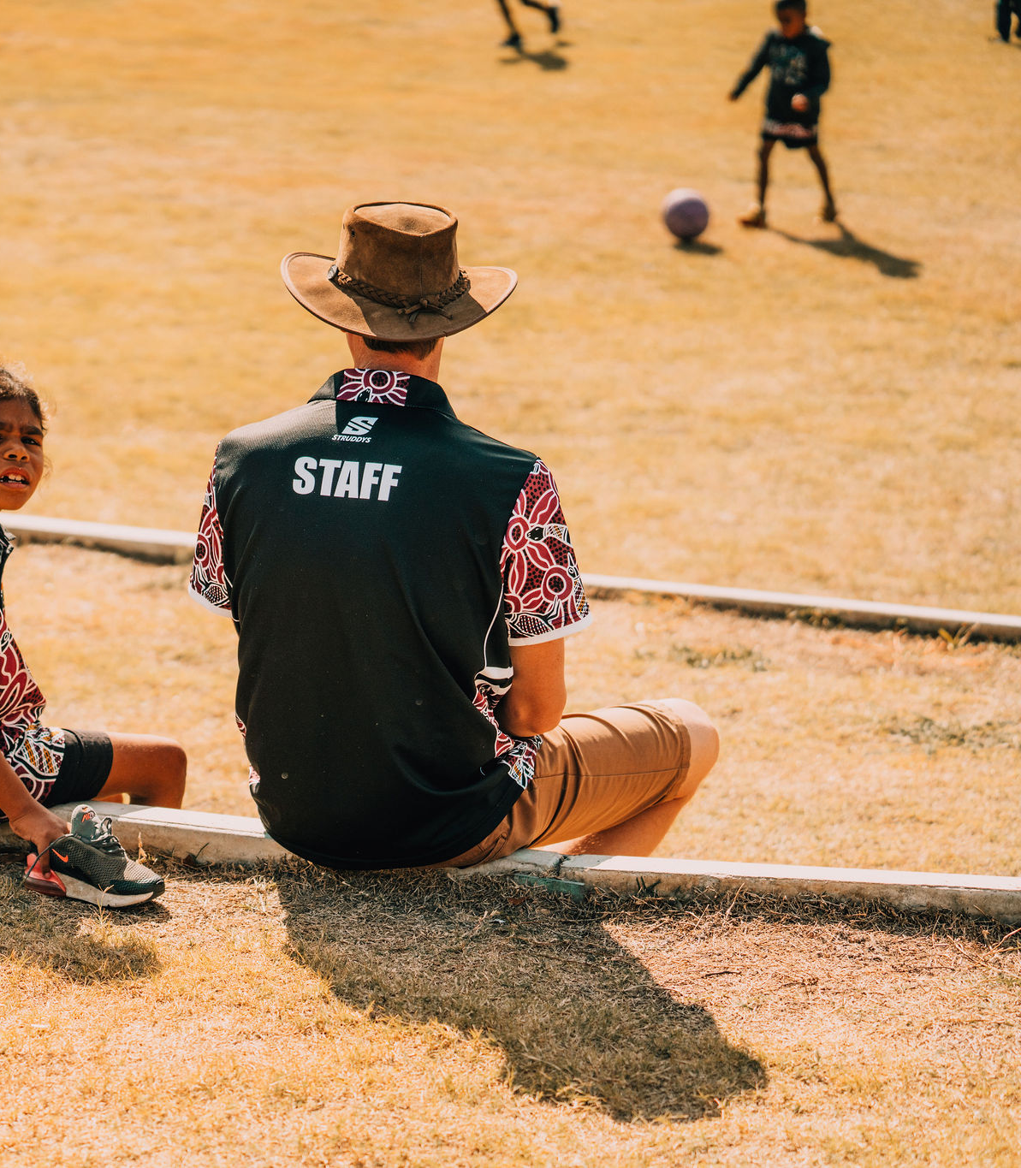
Key takeaways
Leaders remain responsible for maintaining a culture that prioritises children’s safety, even when the organisation relies on volunteers.
Apply clear recruitment, screening and reference‑check processes for all roles, including unpaid positions.
Complete all relevant eligibility checks, including the Working With Children Check and thorough referee checks. Ask about missing periods of a person’s employment history.
Provide induction and regular training for all workers, including volunteers.
Ensure volunteers know how to recognise, respond to and report harm, with clear pathways outlined in policy.
Based on what you have heard about this Standard, discuss the actions you need to take to implement it in your organisation
Notes:
Additional takeaways you may want to consider for this standard and scenario:
Volunteers need to behave in the same way as is expected from workers when it comes to children’s safety.
Workers come from varied backgrounds. Organisations should ensure all workers understand and respect the diverse needs of children and information is provided to them in ways they understand and can apply.
Involve children and families in determining what are the characteristics of a model volunteer and include them in recruitment processes.
The organisation should have clear recruitment, screening and reference-check processes, even for unpaid roles.
Organisations should consider all relevant eligibility checks, for relevant roles this may require a Working With Children Check.
All workers, including volunteers, require induction and regular training.
Workers, including volunteers, must understand how to respond if they discover harm may be occurring and/or respond if a child discloses harm or abuse, and know the reporting pathways within the organisation, which should be clearly outlined in policy documents.
All workers and volunteers should be conscious of the cultural backgrounds of the children they will be working with and the organisation’s approach to creating culturally safe environments for children and families to ensure children are worked with are appropriate and most effective.

Slide 28


Watch the video then discuss:
What do we do well?
Where could we improve?
What is currently missing or not done?
WATCH Standard 8: Physical and online environments
28
Notes:
Tip: Refer to pages 23-25 of the Self-Assessment tool for more prompts to guide your reflection on Physical and Online Environments.

Slide 29



Scenario
A concern has been raised about parents taking photographs which inadvertently capture other children, sharing these images on social media and identifying the organisation in their posts.
In your organisation:
How do you currently manage situations like this?
What do you currently have in place to ensure children remain safe? Would you need to involve other expertise within your organisation or seek any further information?
How do you embed cultural safety?
What evidence do you already have to demonstrate how you safeguard children in these situations?
What do you need to develop to fill any gaps?
In this scenario:
How does Child Safe Standard 8 apply?
What other Standards could apply?
What are the potential risks to children and the organisation, if the Standards are not embedded?
What reflection and feedback processes could be implemented to ensure you are continuously improving?
Notes:
Guidance
This scenario considers multiple Child Safe Standards, which include cultural safety:
Standard 1: Leadership and Culture
Standard 2: Voice of Children
Standard 3: Family and Community
Standard 4: Equity and Diversity
Standard 6: Complaints Management
Standard 8: Physical and online environments
Standard 10: Policies and Procedures
First discuss how the standards apply to the scenario.
Then reflect on how you manage situations like this in your organisation.

Slide 30

Key takeaways – online environments
Organisations’ online environments must be safe for children—this includes social media and messaging platforms.
Have clear policies relating to workers’ engagement with children online—these should be explicit in codes of conduct and reinforced through training.
Maintain clear photography and image‑consent policies to safeguard children.
Ensure strong monitoring and response processes for online risks, which can include cyberbullying, inappropriate comments and inappropriate images.
Have clear procedures for managing negative social media commentary involving children.
Ensure children and families can report concerning contact made online by an adult and respond promptly if a child discloses that they are worried about something they have experienced online.
Based on what you have heard about this Standard, discuss the actions you need to take to implement it in your organisation

Slide 31
Scenario
An organisation is considering the design of their facilities ahead of a refurbishment. The organisation cares for children who are of different ages and abilities, from different cultural backgrounds, and with varied lived experiences.
In your organisation:
How do you currently manage situations like this?
What do you currently have in place to ensure children remain safe? Would you need to involve other expertise within your organisation or seek any further information?
How do you embed cultural safety?
What evidence do you already have to demonstrate how you safeguard children in these situations?
What do you need to develop to fill any gaps?
In this scenario:
How does Child Safe Standard 8 apply?
What other Standards could apply?
What are the potential risks to children and the organisation if the Standards are not embedded?
What reflection and feedback processes could be implemented to ensure you are continuously improving?
Notes:
Guidance
This scenario considers multiple Child Safe Standards, which include cultural safety:
Standard 1: Leadership and Culture
Standard 2: Voice of Children
Standard 3: Family and Community
Standard 4: Equity and Diversity
Standard 8: Physical and Online environments
Standard 9: Continuous Improvement
Standard 10: Policies and practices
First discuss how the standards apply to the scenario.
Then reflect on how you manage situations like this in your organisation.

Slide 32
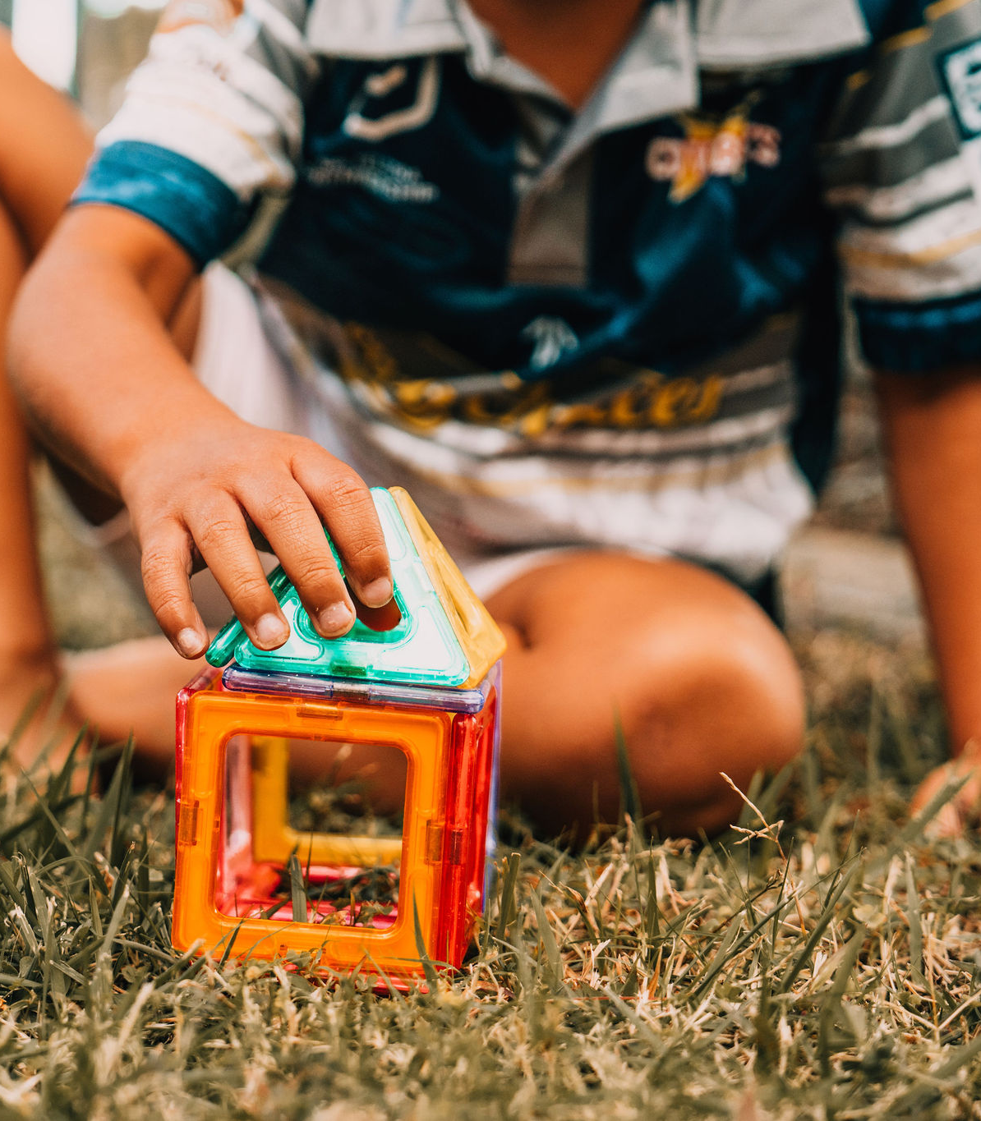
Key takeaways – physical environments
Design and manage physical environments to meet the unique needs and circumstances of the children who will use them.
Create environments that eliminate opportunities for harm, including clear sightlines and safe supervision points. Monitor spaces regularly and respond promptly to safety concerns or emerging risks.
Train staff to recognise breaches of protocols in physical environment and either address or report them.
Maintain clear procedures for managing breaches of policies and unsafe behaviours or interactions in physical settings. Ensure staff know how to identify and respond to inappropriate contact or interactions.
Where suitable and appropriate, display information about children’s safety, for example, posters, signage, brochures or information.
Seek feedback from children and families about how safe they feel in physical spaces and act on what they tell you.
Based on what you have heard about this Standard, discuss the actions you need to take to implement it in your organisation
Notes:
Additional takeaways you may want to consider for this standard and scenario:
People who seek to harm children will often manipulate physical environments to hide misconduct. Workers need to be able to recognise situations when this happens and rectify the setting and immediately report it.
Physical environments must minimise opportunities for workers to be alone and out of sight of other workers. Where this is required for operational reasons, the organisation needs to have strict risk management processes in place to identify risks and address them. This can include ensuring children and other workers have pathways to report concerns.
Organisations should have clear policies about the use of recording equipment around children. These must be strictly enforced in scenarios where children may use toilets, get changed, or be in personal settings.
These should be well communicated to everyone who interacts with the organisation—workers, volunteers and families—and acted on.
In addition to risks of sexual or physical harm, look at how you can mitigate hazards in the areas that children use, such as trips/slip points, unsecured areas and the safety standards of equipment.
You need to consider the accessibility needs of children living with disability. Consider how you can make the physical setting welcoming for all children of all cultures.
When designing spaces, programs or services for children, consider how you can engage children in the process and seek their views about how they would feel safe in that setting. Consider how you can do this to ensure cultural safety.
Regularly ask whether children feel safe when interacting with your organisation.
Creating spaces where children know about their right to safety and are confident in their ability to express concerns, provide input, and participate in meaningful ways is an important aspect of prioritising their safety. You can communicate this to children in conversations, through posters on your site, surveys, or in information provided through parents. These are just some examples. How you seek the views of children will be different for every organisation depending on how you interact with children, your resourcing, and circumstances.

Slide 33
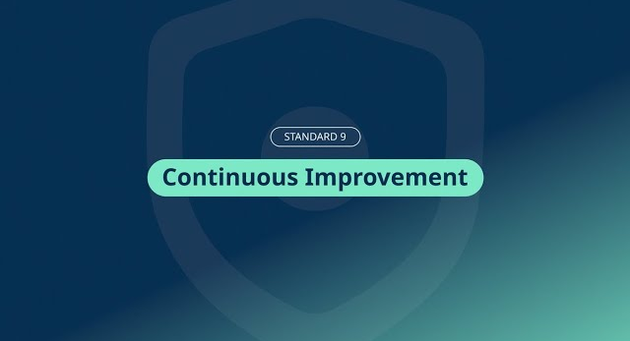

Watch the video then discuss:
What do we do well?
Where could we improve?
What is currently missing or not done?
WATCH Standard 9: Continuous improvement
33
Notes:
Tip: Refer to pages 26-27 of the Self-Assessment tool for more prompts to guide your reflection on Continuous Improvement.

Slide 34



Scenario
An organisation makes great progress in implementing the Standards. Training was updated and rolled out, policies and practices were reviewed and launched, and a commitment to launching a parent survey was made.
Eighteen months later, there has been no further progress.
In your organisation:
How do you currently manage situations like this?
What do you currently have in place to ensure children remain safe? Would you need to involve other expertise within your organisation or seek any further information?
How do you embed cultural safety?
What evidence do you already have to demonstrate how you safeguard children in these situations?
What do you need to develop to fill any gaps?
In this scenario:
How does Child Safe Standard 9 apply?
What other Standards could apply?
What are the potential risks to children and the organisation if the Standards are not embedded?
What reflection and feedback processes could be implemented to ensure you are continuously improving?
Notes:
Guidance
This scenario considers multiple Child Safe Standards, which include cultural safety:
Standard 1: Leadership and Culture
Standard 5: People
Standard 6: Complaints Management
Standard 7: Knowledge and Skills
Standard 9: Continuous Improvement
Standard 10: Policies and Procedures
First discuss how the standards apply to the scenario.
Then reflect on how you manage situations like this in your organisation.

Slide 35

Key takeaways
Continuous improvement is a dynamic process that requires constant reflection on what is working and, where challenges or gaps exist, is prioritised. It’s also fundamental to prioritising children’s safety.
Regularly review data from feedback, complaints and incidents to identify trends and systemic issues and develop actions in response.
Provide ongoing training to workers so they are equipped with contemporary information to protect children from harm. This training should cover safe practices, identifying risks, listening to children, managing disclosures, and effective reporting.
Treat outcomes of audits as opportunities to improve—audit findings must lead to a measurable action plan with clear responsibilities, timelines and progress indicators.
Based on what you have heard about this Standard, discuss the actions you need to take to implement it in your organisation
Notes:
Guidance
Additional takeaways you may want to consider for this standard and scenario:
Complying with the Child Safe Standards means your organisation is continually engaging with the standards. It means continually reviewing its operations to make sure they are as safe as they can be.
When children’s safety is not prioritised in decision-making, leadership has not fully embedded a child safe culture, and workers may view safeguarding as ‘compliance-based paperwork’ rather than a core organisational value. Leaders should model, communicate and reinforce that children’s safety is central to all decisions.

Slide 36


Watch the video then discuss:
What do we do well?
Where could we improve?
What is currently missing or not done?
WATCH Standard 10: Policy and procedures
36
Notes:
Tip: Refer to pages 28-29 of the Self-Assessment tool for more prompts to guide your reflection on Policy and Procedures.

Slide 37




Scenario
An organisation engages an external worker to deliver a program or service to children. The service could include a sports coach, music teacher, allied health professionals, etc.
In your organisation:
How do you currently manage situations like this?
What do you currently have in place to ensure children remain safe? Would you need to involve other expertise within your organisation or seek any further information?
How do you embed cultural safety?
What evidence do you already have to demonstrate how you safeguard children in these situations?
What do you need to develop to fill any gaps?
In this scenario:
How does Child Safe Standard 10 apply?
What other Standards could apply?
What are the potential risks to children and the organisation if the Standards are not embedded?
What reflection and feedback processes could be implemented to ensure you are continuously improving?
Notes:
Guidance
This scenario considers multiple Child Safe Standards, which include cultural safety:
Standard 1: Leadership and Culture
Standard 2: Voice of Children
Standard 3: Family and community
Standard 4: Equity and Diversity
Standard 5: People
Standard 6: Complaints Management
Standard 7: Knowledge and Skills
Standard 8: Physical and online environments
Standard 10: Policies and Procedures
First discuss how the standards apply to the scenario.
Then reflect on how you manage situations like this in your organisation.

Slide 38

Key takeaways
The organisation remains responsible for ensuring child‑safe practices, even when services are delivered by external providers.
All external contractors should be provided with an appropriate induction that details expectations around interacting with children, recognising signs or risks of harm, and knowing how and where to report concerns.
Ensure internal staff who oversee contractors understand their supervisory and reporting responsibilities.
Details of contractors who engage with children should be maintained as part of corporate records.
Establish a process to review external service arrangements to identify successes, learnings and risks, and drive continuous improvement.
Based on what you have heard about this Standard, discuss the actions you need to take to implement it in your organisation
Notes:
Additional takeaways you may want to consider for this standard and scenario:
The organisation retains responsibility for child safe practices, even when services are delivered by external people. Outsourcing does not transfer accountability for ensuring the environment is safe. Contractors have the same expectations as workers and volunteers.
As the individual will have direct contact with children, they must be screened, qualified, and appropriately supported, including checking for Blue Card requirements.
The organisation should also conduct referee checks, professional conduct history and ensure the external individual’s business has also implemented child safe practices.
A record should be kept of all training completed and dates for training refresh and blue card expiry.
Ensure the organisation’s complaints process clearly applies to external service providers, and make sure the contractor knows how to report incidents or disclosures themselves.
External programs or services may introduce new risks, e.g. unfamiliar activities or different supervision ratios. A risk assessment specific to the external program should be undertaken.
The organisation should ensure they establish a process to review the arrangement to identify successes, learnings and risks so they can continuously improve.

Slide 39
Scenario
An organisation engages an external contractor to do some maintenance on their building (for example, painting or plumbing). The contractors will only have incidental contact with children. They will be on site for five days.
In your organisation:
How do you currently manage situations like this?
What do you currently have in place to ensure children remain safe? Would you need to involve other expertise within your organisation or seek any further information?
How do you embed cultural safety?
What evidence do you already have to demonstrate how you safeguard children in these situations?
What do you need to develop to fill any gaps?
In this scenario:
How does Child Safe Standard 10 apply?
What other Standards could apply?
What are the potential risks to children and the organisation if the Standards are not embedded?
What reflection and feedback processes could be implemented to ensure you are continuously improving?
Notes:
Guidance
This scenario considers multiple Child Safe Standards, which include cultural safety:
Standard 1: Leadership and Culture
Standard 5: People
Standard 6: Complaints Management
Standard 8: Physical and Online environments
Standard 9: Continuous Improvement
Standard 10: Policies and Procedures
First discuss how the standards apply to the scenario.
Then reflect on how you manage situations like this in your organisation.

Slide 40

Key takeaways
Leaders must ensure child‑safe expectations apply to everyone on site, including short‑term contractors.
Internal staff must understand how to manage and monitor contractors safely, including who is responsible for oversight and how to respond to concerns.
Contractors should be clearly briefed on expected behaviour, unacceptable conduct, and reporting obligations.
Conduct a risk assessment before work begins and continually assess dynamic risks, implementing mitigations as required.
Treat each contractor engagement as an opportunity to review and improve contractor management and risk processes.
Based on what you have heard about this Standard, discuss the actions you need to take to implement it in your organisation
Notes:
Guidance
Additional takeaways you may want to consider for this standard and scenario:
Even when contact with children is incidental, obligations for child safe practices still apply. The difference is how risk is managed, not whether it exists.
Leadership must ensure that child safe practices and expectations extend to everyone who enters the site, even short-term contractors. A child safe culture means no exceptions based on duration or job type.
The contractors may not require a Blue Card, but suitability is still important. The organisation should confirm the contractor’s reputation and professionalism and they should ensure that contractors are never alone with children or have unsupervised access to child spaces.
The organisation’s own workers need to understand how to manage contractors safely. Everyone should know who is responsible for monitoring the contractors and how to respond to any concerns.
The contractors should be briefed on expectations, unacceptable and acceptable behaviour and reporting obligations.
Maintenance work can temporarily change physical safety conditions. Ensure a temporary risk assessment is conducted before the work commences, dynamic risks are assessed on an ongoing basis while work continues with appropriate mitigations implemented as necessary.
Organisations responsibility is to make surrounding employees, children and families aware of contractors being present to ensure clear communication and ability to communicate any questions or issues. This allows for better transparency and understanding of the environment of the children’s care especially if there is any concerns raised.
Each engagement with external providers provides an opportunity to review and refine contractor management systems and risk management.

Slide 41

The Universal Principle
When implementing the Child Safe Standards, organisations also need to create environments that promote and uphold the right to cultural safety for Aboriginal and Torres Strait Islander children. This is known in the legislation as the Universal Principle.
There’s no one-size-fits-all approach, but generally speaking, culturally safe environments have some things in common:
Aboriginal and Torres Strait Islander peoples feel welcome, valued, safe, included and respected
leaders consider cultural safety as part of daily operations
people and policies prevent and address racism and discrimination
Aboriginal and Torres Strait Islander children are meaningfully involved in the decisions that affect them
Aboriginal and Torres Strait Islander peoples define and measure cultural safety.
Notes:
Guidance
Refer to the Quick Reference Guide for more details on how the Universal Principle applies to the Standards.

Slide 42
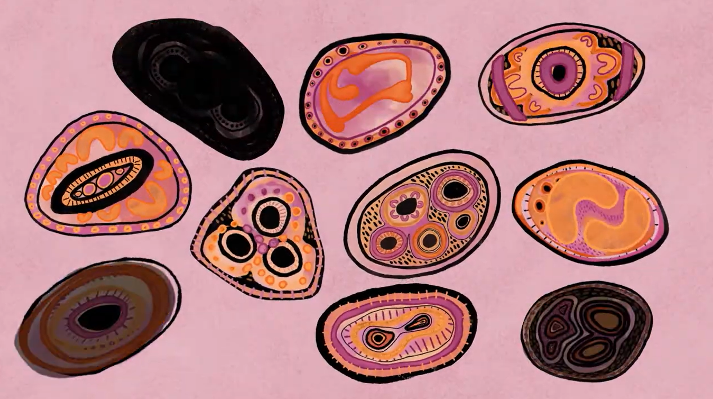

Watch Video – Voice of Children
Watch the video to understand how cultural safety looks within the Standards. Discuss:
How do we create a culturally safe environment?
Where could we improve?
Consider this as you work through the Standards.
WATCH Understanding Cultural Safety in Child Safe Organisations
Notes:
GUIDANCE
Watch the video about cultural safety and the Standards. It was produced by the National Office of Child Safety in consultation with SNAICC, which is the peak body for Aboriginal and Torres Strait Islander children, families, and community-controlled organisations in Australia.

Slide 43
Assess, plan and commit
Self-assessment, action planning and continuous improvement

Slide 44
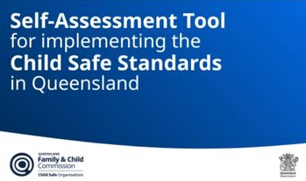
Discuss and record in your Self-Assessment Tool
Now that you have worked through the Standards and have reflected on your practices, you can start to assess your progress and the actions you need to take to better prioritise children’s safety.
You can use the Self-Assessment Tool to help you.
Notes:
Access the Self-Assessment Tool on our the Queensland Family and Child Commission’s website: https://www.qfcc.qld.gov.au/childsafe/resources

Slide 45

Identify the actions you will take and record them
What improvements or changes are needed to prioritise children’s safety?
Is this a foundational action required before others?
What resources, people or support will we need?
What are our quick wins vs longer-term actions?
How will we know this action has been successful?
When will we again review our progress?

Slide 46
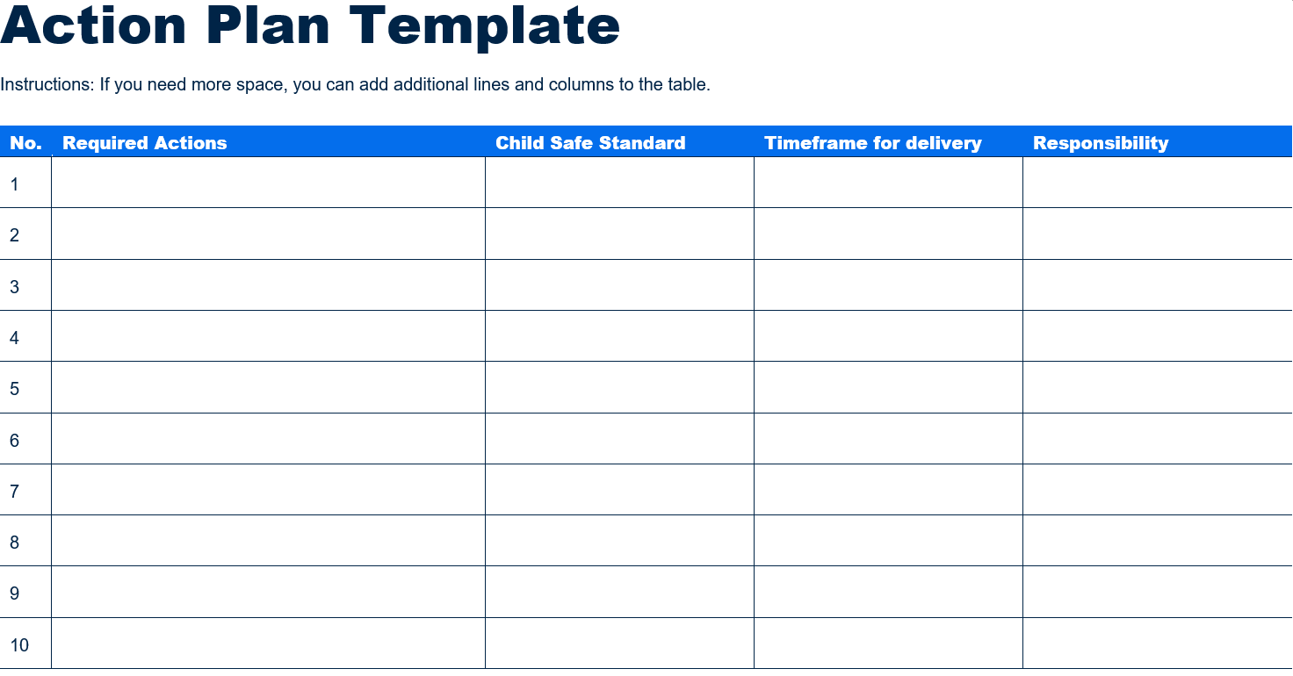
Action planning
Create your action plan.
An action plan template is included in the Self-Assessment Tool, which may help.
Define your actions
What actions will we take to strengthen our practice for each standard?
Which gaps or risks does each action address?
Is this a foundational action we must complete before others?
Assign responsibility and timeframes
Who is responsible for leading this action?
Who else needs to be involved?
When will we complete it?
When will we revisit or review progress?
46

Slide 47

Thank you for protecting our children’s safety

